Slide 1
Word2Vec embeddings
And their applications

Slide 2
What is word embedding?

Slide 3
One more example and how embeddings are useful
A common red column passes through all vectors
The columns of a “Woman” and a “Girl” are quite similar, the same situation with a “Man” and a “Boy”
"Boy" and "Girl" are also similar in some dimensions, but different from ”Woman" and ”Man". Maybe this is a vague idea of youth encoded?
Water is quite different from all people words.
There are also columns where the “King” and “Queen” are very different from the rest of the words.

Slide 4
Embeddings also understand analogies!

Slide 5
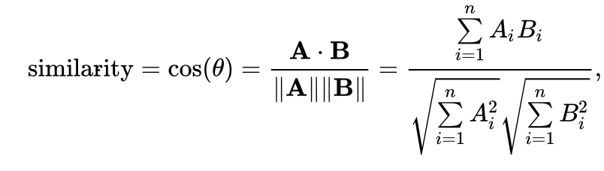
How to compare embeddings?
Of course, the simplest and the most popular way is just use cosine similarity

Slide 6

But before we`ll start to talk about Word2Vec. What was before?

Slide 7
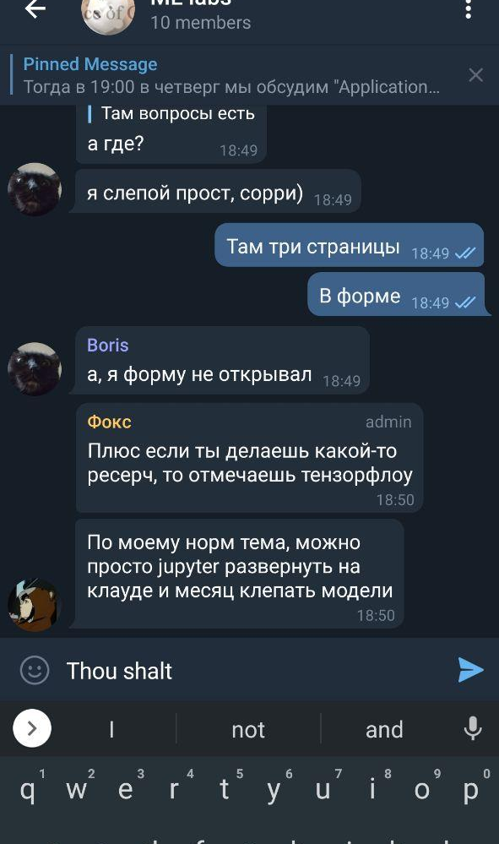
Neural language model

Slide 8
Pipeline#1

Slide 9
Pipeline #2

Slide 10
Pipeline #3 (Bengio 2003)

Slide 11
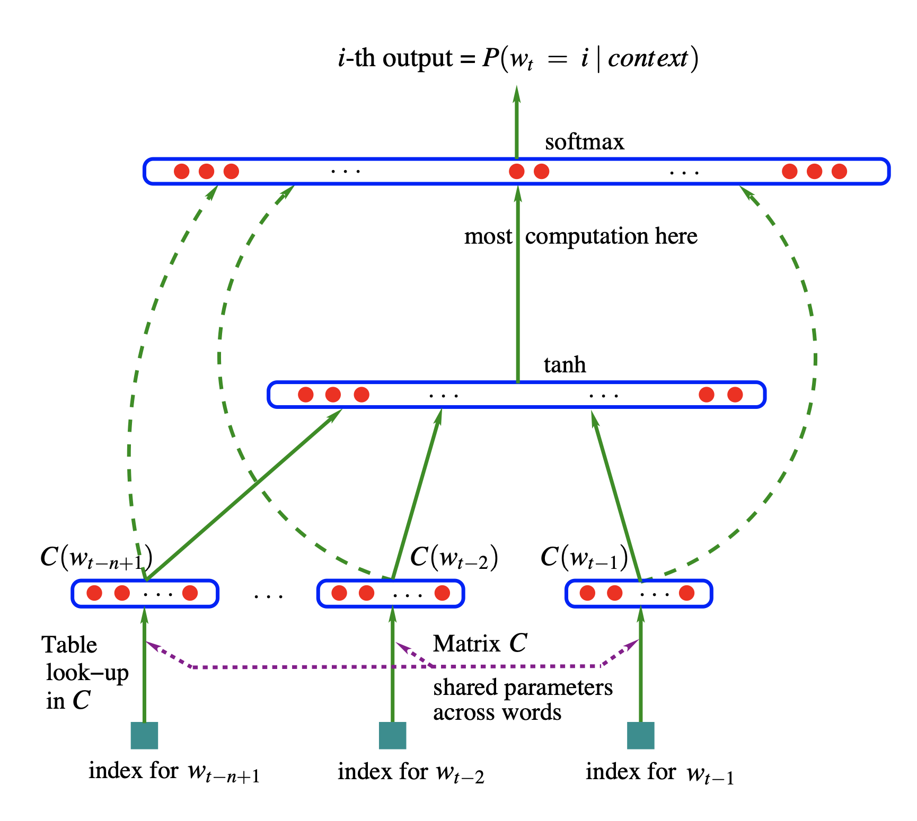
Bengio 2003 model

Slide 12
Training language model
Scrape a lot of text data(We have a lot in the internet, which is a great plus for training language model compared to CV models and others.)
We set a window (for example, three words) that slides over the entire text.
This window will generate input data for model trainings

Slide 13
Continuous bag of words

Slide 14
Now, when we have all the data needed, we can train a neural network.

Slide 15
Negative selection

Slide 16
Skip-gram with negative selection

Slide 17
Word2vec training

Slide 18
Step 1

Slide 19
Step 2

Slide 20
Step 3

Slide 21
Step 4

Slide 22
Step 5

Slide 23

The End!

